Slide 1

IPL AUCTION
Presented By
Daideepya Awadhiya

Slide 2
First Created Table
Create Table IPL_Ball (
id int,
inning int,
over int,
ball int,
batsman varchar,
non_striker varchar,
bowler varchar,
batsman_runs int,
extra_runs int,
total_runs int,
is_wicket int,
dismissal_kind varchar,
player_dismissed varchar,
fielder varchar,
extras_type varchar,
batting_team varchar,
bowling_team varchar);
Create Table IPL_matches (
id Serial Primary Key,
city Varchar,
match_date Date,
player_of_match Varchar,
venue Varchar,
neutral_venue int,
team1 Varchar,
team2 Varchar,
toss_winner Varchar,
toss_decision Varchar,
winner Varchar,
match_result Varchar,
result_margin int,
eliminator Varchar,
method Varchar,
umpire1 Varchar,
umpire2 Varchar);
copy IPL_Ball from 'D:\internshala\SQL\final project\IPL Dataset\IPL_Ball.csv' csv header;
copy IPL_matches from 'D:\internshala\SQL\final project\IPL Dataset\IPL_matches.csv' csv header;
Select * from IPL_Ball
Select * from IPL_matches

Slide 3
Your first priority is to get 2-3 players with high S.R who have faced at least 500 balls. And to do that you have to make a list of 10 players you want to bid in the auction so that when you try to grab them in auction you should not pay the amount greater than you have in the purse for a particular player
Select batsman,
sum(batsman_runs) as Total_runs,
count(ball) as Total_balls,
(sum(batsman_runs) * 100.0) / count(ball) as Strike_rate
from IPL_Ball
where extras_type != 'wides'
group by batsman
having count (ball)>= 500
order by strike_rate desc
limit 10;

Slide 4
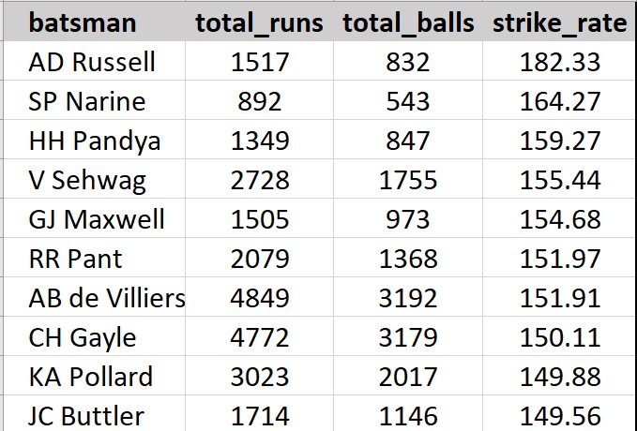
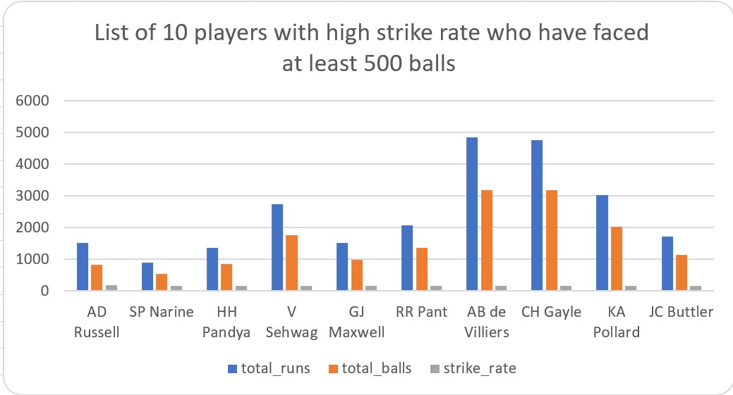
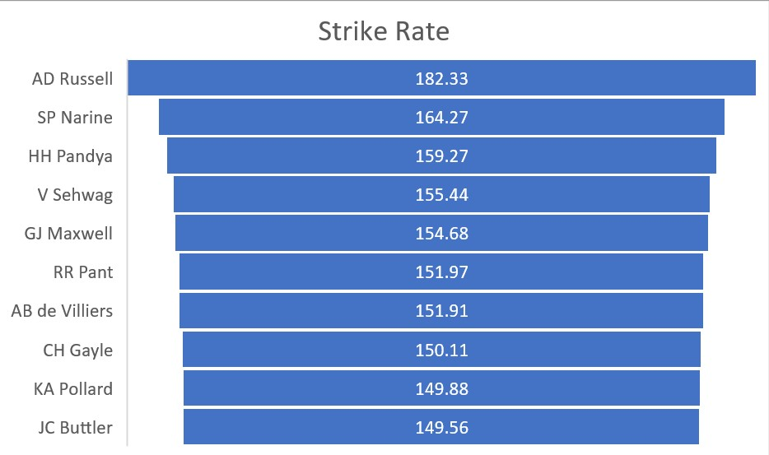
Bidding on Batting
List of 10 players with high strike rate who have faced at least 500 balls
Name of 3 players are with Highest Strike Rate:
AD Russell
SP Narine
HH Pandya

Slide 5
Now you need to get 2-3 players with good Average who have played more than 2 ipl seasons. And to do that you have to make a list of 10 players you want to bid in the auction so that when you try to grab them in auction you should not pay the amount greater than you have in the purse for a particular player.
Select batsman,
Count(Distinct Extract (Year From match_date)) As season_played,
Sum(batsman_runs) As total_runs,
Sum(Case When is_wicket = 1 Then 1 Else 0 End) As wicket_ball,
Sum(batsman_runs) / Nullif(Sum(Case When is_wicket = 1 Then 1 Else 0 End), 0) As avg_runs
From IPL_Ball
Inner Join IPL_Matches On IPL_Ball.id = IPL_Matches.id
Group by batsman
Having Count(Distinct Extract(Year From match_date)) > 2
And count (ball) > 500
Order by avg_runs desc
Limit 10;

Slide 6
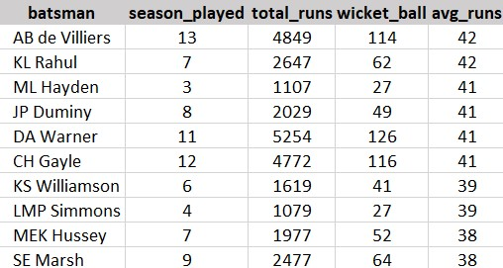
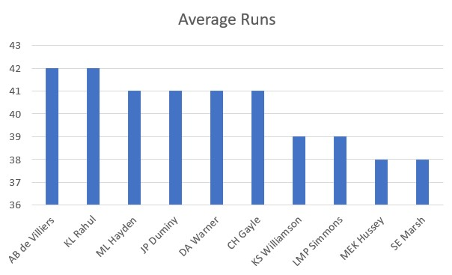
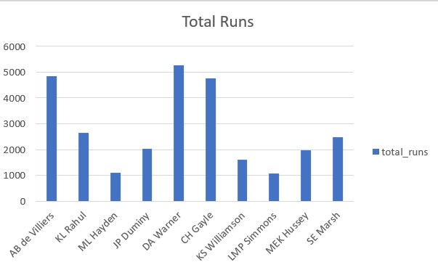
List of 10 players with good average rate who have played more than 2 IPl
seasons
Name of 3 players with good average rate
AB de Villiers
KL Rahul
ML Hayden

Slide 7
Now you need to get 2-3 Hard-hitting players who have scored most runs in boundaries and have played more the 2 ipl season. To do that you have to make a list of 10 players you want to bid in the auction so that when you try to grab them in auction you should not pay the amount greater than you have in the purse for a particular player.
Select a.batsman,
a.batting_team,
Count(Distinct Extract(Year From b.match_date)) As season_played,
Sum(a.batsman_runs) As total_runs,
Sum(Case When a.batsman_runs In (4, 6) Then 1 Else 0 End) As total_boundaries
From IPL_Ball As a
Inner join IPL_Matches As b On a.id = b.id
Group by a.batsman, a.batting_team
Having Count(Distinct Extract(Year from b.match_date)) > 2
And Sum(Case when a.batsman_runs In (4, 6) Then 1 else 0 End) > 0
Order by total_boundaries Desc
Limit 10;

Slide 8
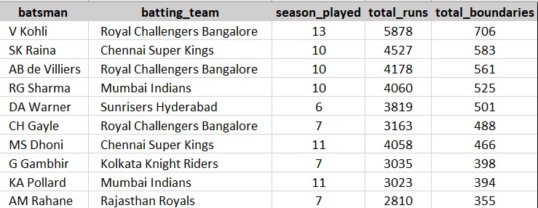
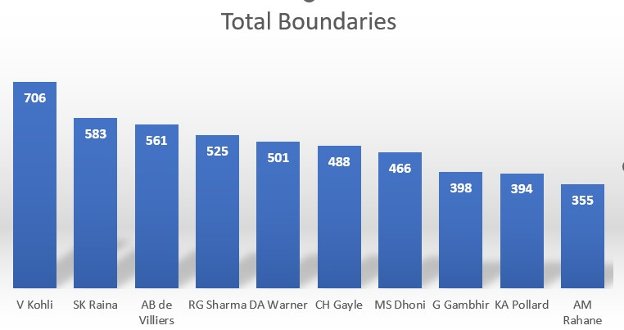
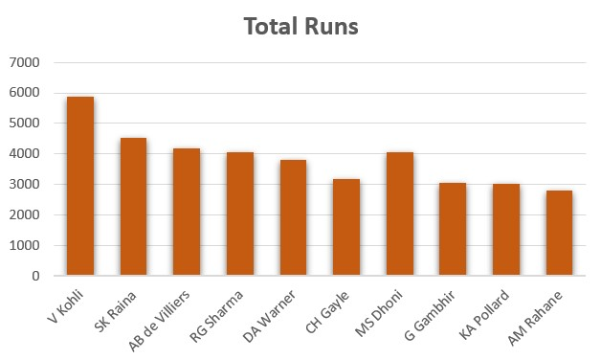
List of 10 players who have scored most runs in boundaries and have played more the 2 IPL season
3 Hard-hitting players who have scored most runs in boundaries
and have played more the 2 ipl season
Virat Kohli
SK Raina
AB De Villiers

Slide 9
Bidding on Bowlers
Your first priority is to get 2-3 bowlers with good economy who have bowled at least 500 balls in IPL so far.To do that you have to make a list of 10 players you want to bid in the auction so that when you try to grab them in auction you should not pay the amount greater than you have in the purse for a particular player
Select bowler,
Sum(total_runs) *100 / (Sum(over) + Sum(ball) / 6.0) As economy_rate
From IPL_Ball Group by bowler
Having Count(*) >= 500
Order by economy_rate Asc
Limit 10;

Slide 10
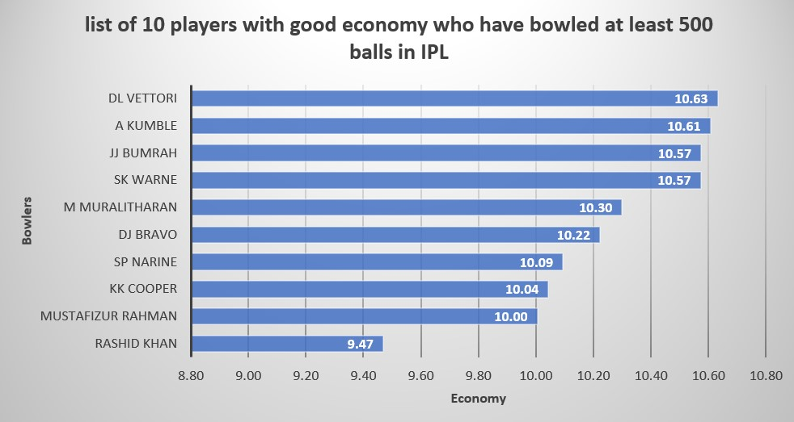
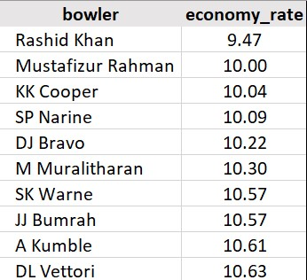
List of 10 players with good economy who have bowled at least 500 balls in IPL so far
3 bowlers with good economy who have bowled at least 500 balls in IPL
DL Vettori
A Kumble
JJ Bumrah

Slide 11
Now you need to get 2-3 bowlers with the best strike rate and who have bowled at least 500 balls in IPL so far.To do that you have to make a list of 10 players you want to bid in the auction so that when you try to grab them in auction you should not pay the amount greater than you have in the purse for a particular player.
Select bowler,
sum(total_runs) as total_runs_given,
sum(total_balls)/6 as total_overs_bowled,
sum(case when is_wicket = 1 then 1 else 0 end) as total_wickets,
sum(total_balls)/ sum(case when is_wicket = 1 then 1 else 0 end) as strike_rate
from(select bowler,
sum(batsman_runs)as total_runs,
count(ball) as total_balls,
sum(case when dismissal_kind in('caught','lbw','bowled') then 1 else 0 end)as is_wicket
from IPL_Ball
where extras_type != 'wide'
group by bowler, id
)as bowler_stats
group by bowler
having sum(total_balls)>=500
order by strike_rate asc
limit 10;

Slide 12
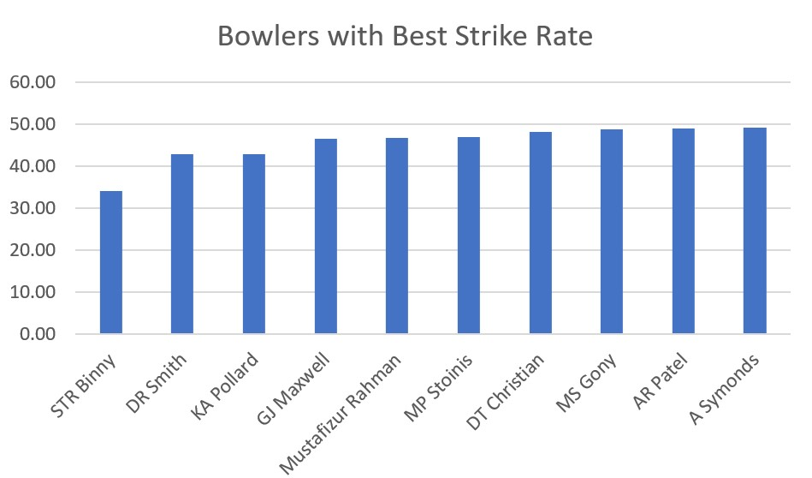
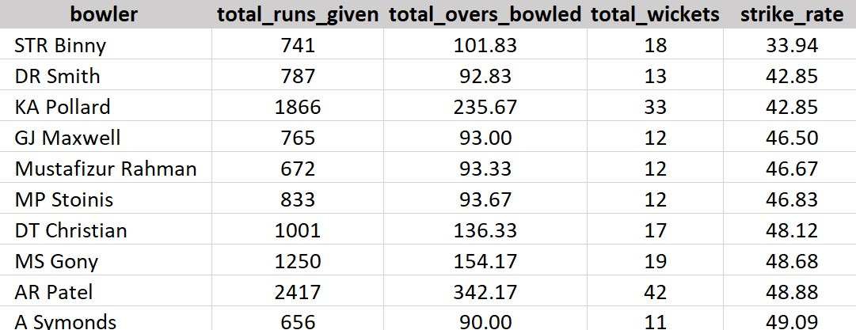
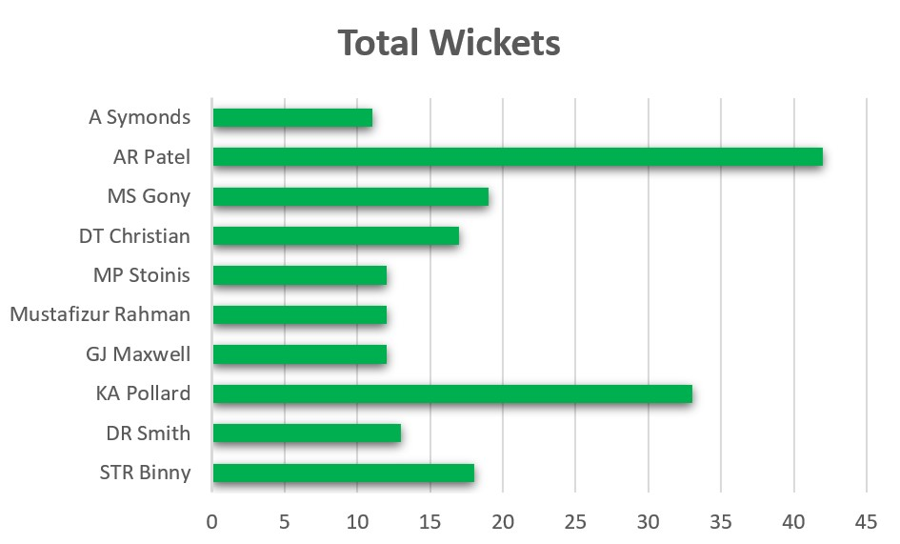
List of 10 players with All rounders with the best batting as well as bowling strike rate and who have faced at least 500 balls in IPL so far and have bowled minimum 300 balls
Top 3 Bowlers
STR Binny
DR Smith
KA Pollard

Slide 13
All-Rounders
Now you need to get 2-3 All rounders with the best batting as well as bowling strike rate and who have faced at least 500 balls in IPL so far and have bowled minimum 300 balls. To do that you have to make a list of 10 players you want to bid in the auction so that when you try to grab them in auction you should not pay the amount greater than you have in the purse for a particular player.
With AllRounderStats As (
Select batsman,
Count(*) As balls_faced,
Sum(batsman_runs) As total_runs
From IPL_Ball
Group by batsman
Having count(*) >= 500),
BowlerStats As (select bowler, Count(*) As balls_bowled,
Count(Case When is_wicket = 1 Then 1 End) As total_wickets From IPL_Ball
Group by bowler
Having count(*) >= 300),
AllRounders As (Select
a.batsman,
a.total_runs,
a.balls_faced,
b.balls_bowled,
b.total_wickets,
(Cast(a.total_runs As Decimal) *100 / Nullif(a.balls_faced, 0)) As batting_strike_rate,
(CAST(b.balls_bowled AS Decimal) / Nullif(b.total_wickets, 0)) As bowling_strike_rate
From AllRounderStats a
Join BowlerStats b On a.batsman = b.bowler)
Select batsman, batting_strike_rate As batting_sr, bowling_strike_rate AS bowling_sr
From AllRounders
Order by batting_strike_rate Desc, bowling_strike_rate Asc
Limit 10;

Slide 14
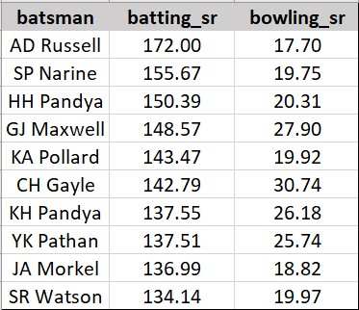
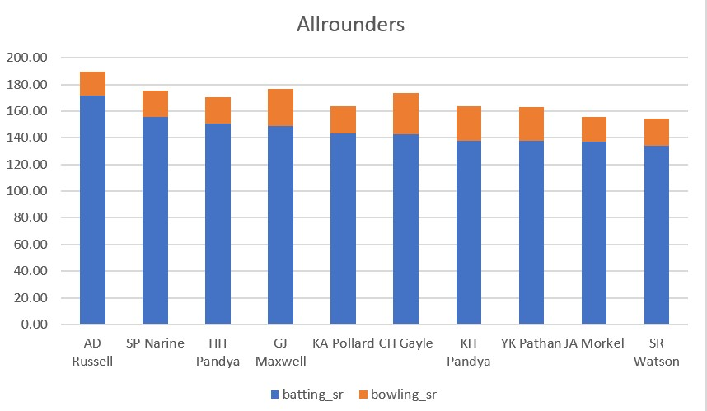
List of 10 players with All Rounders with the best batting as well as bowling strike rate and who have faced at least 500 balls in IPL so far and have bowled minimum 300 balls
Top 3 All Rounders
AD Russel
SP Narine
HH Pandya

Slide 15
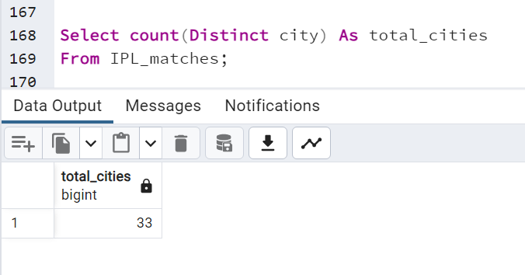
Additional Questions for Final Assessment
1) Get the count of cities that have hosted an IPL match
Cities count: 33

Slide 16
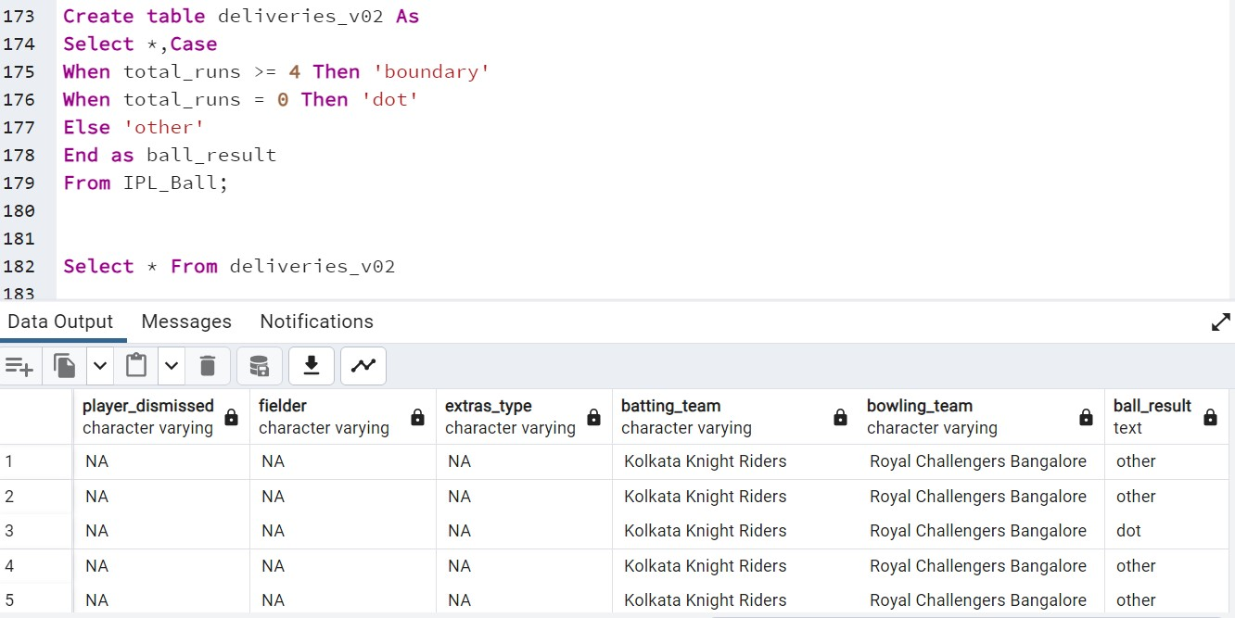
2) Create table deliveries_v02 with all the columns of the table ‘deliveries’ and an additional
column ball_result containing values boundary, dot or other depending on the total_run

Slide 17
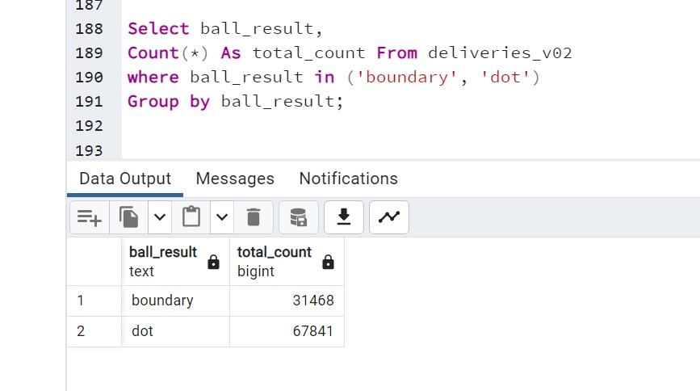
3) Write a query to fetch the total number of boundaries and dot balls from the deliveries_v02 table.

Slide 18
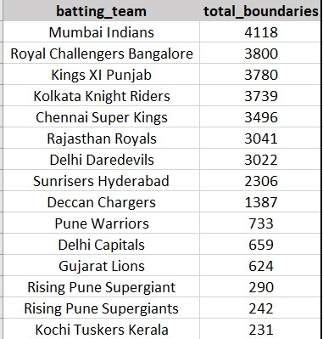
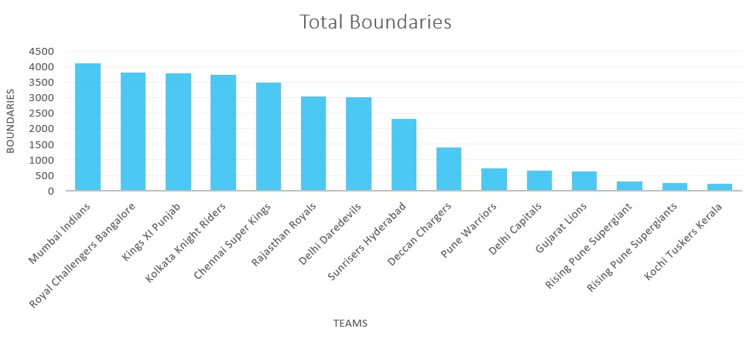
4) Write a query to fetch the total number of boundaries scored by each team from the deliveries_v02 table and order it in descending order of the number of boundaries scored
Select batting_team,
Count(Case when ball_result = 'boundary' Then 1 End) As total_boundaries From deliveries_v02
Where ball_result = 'boundary'
Group by batting_team
Order by total_boundaries Desc;

Slide 19
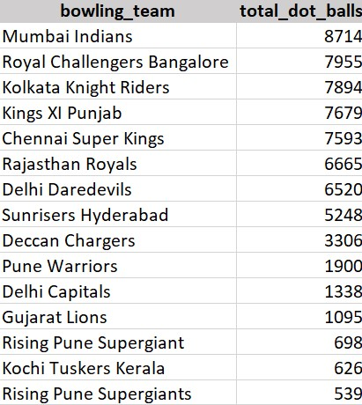
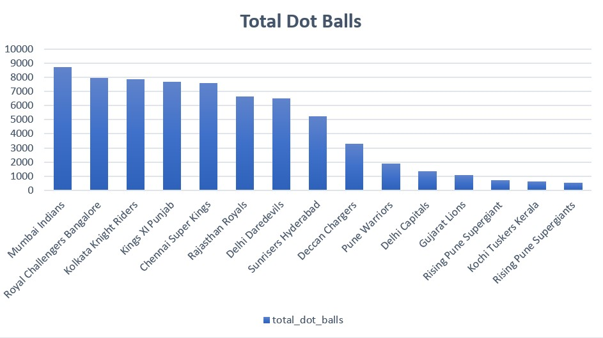
5) Write a query to fetch the total number of dot balls bowled by each team and order it in descending order of the total number of dot balls bowled
Select bowling_team,
Count(Case When ball_result = 'dot' Then 1 End) As total_dot_balls From deliveries_v02
Where ball_result = 'dot'
Group by bowling_team
Order by total_dot_balls Desc;

Slide 20
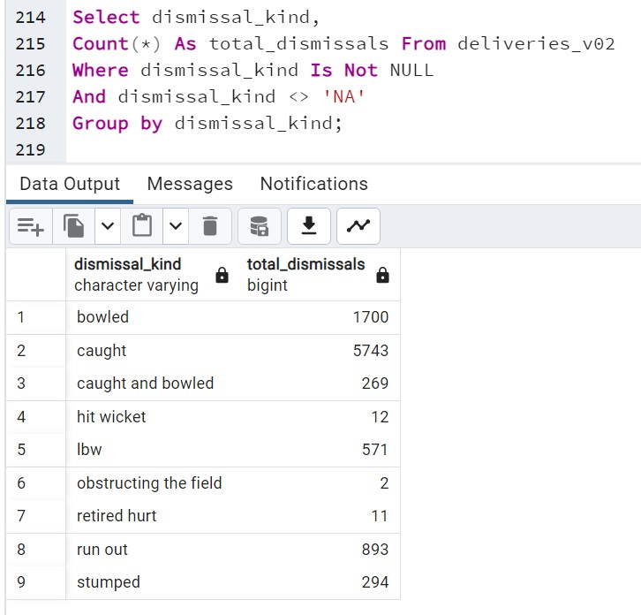
6) Write a query to fetch the total number of dismissals by dismissal kinds where dismissal kind is not NA

Slide 21
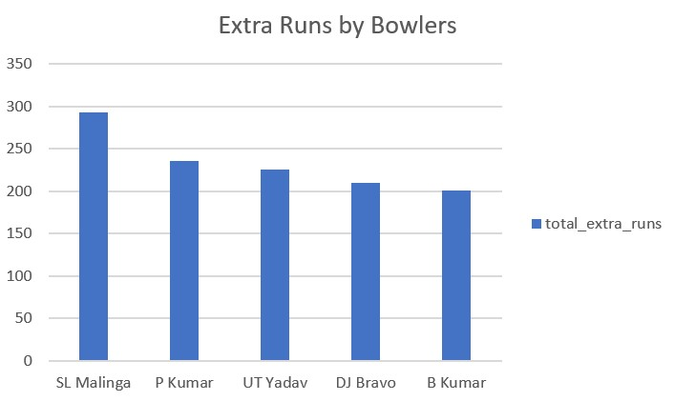
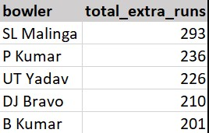
7) Write a query to get the top 5 bowlers who conceded maximum extra runs from the deliveries table
Select bowler,
Sum(extra_runs) As total_extra_runs
From IPL_Ball
Group by bowler
Order by total_extra_runs Desc
Limit 5;

Slide 22
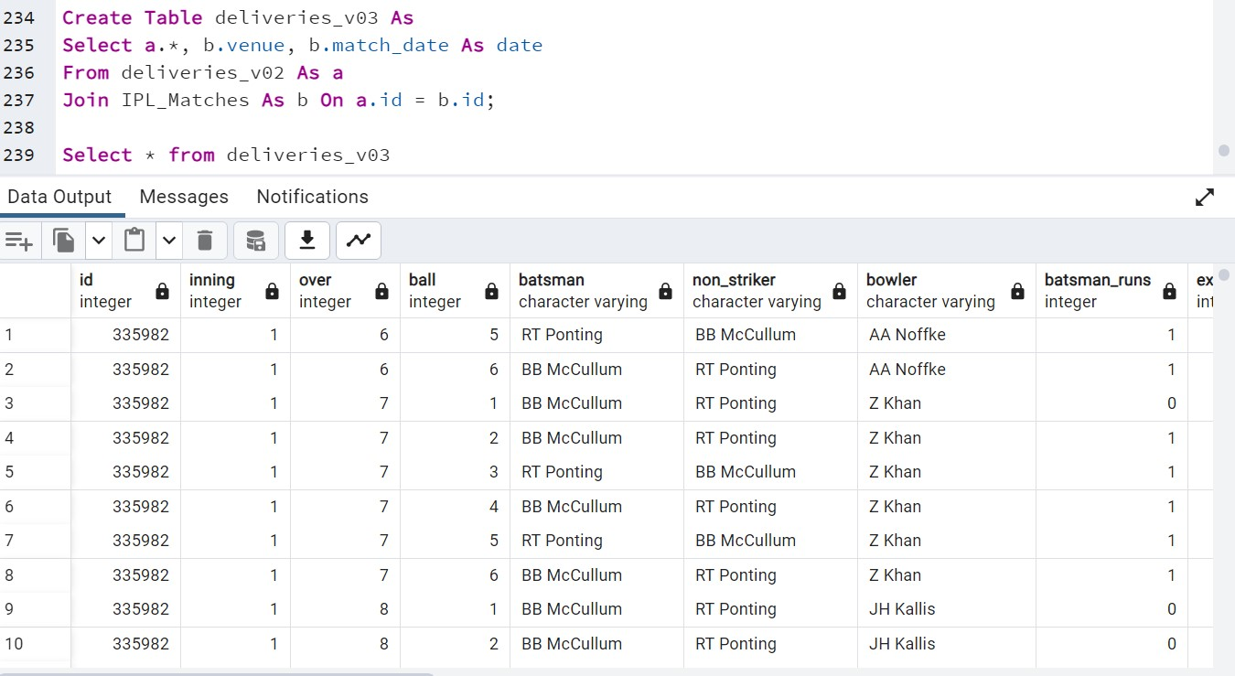
8) Write a query to create a table named deliveries_v03 with all the columns of deliveries_v02 table and two additional column (named venue and match_date) of venue and date from table matches

Slide 23
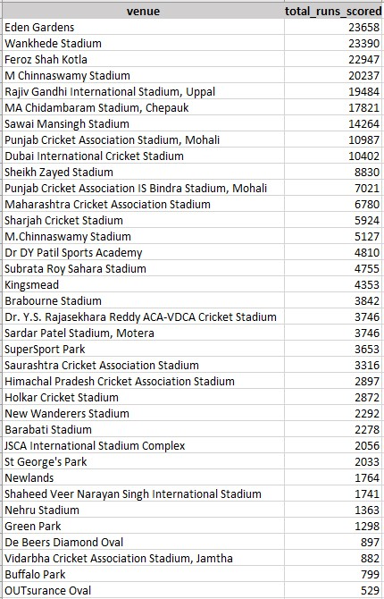
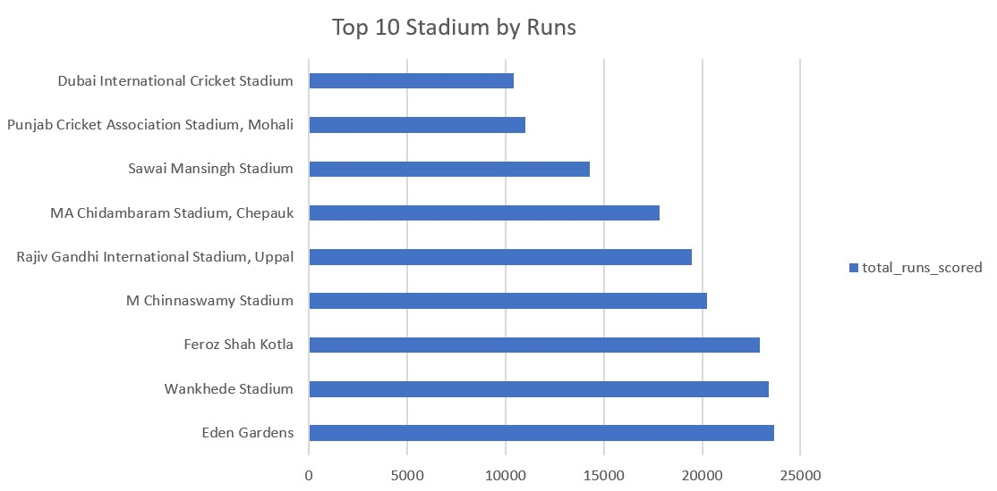
9) Write a query to fetch the total runs scored for each venue and order it in the descending order of total runs scored.
Select venue,
Sum (total_runs) As total_runs_scored
From deliveries_v03
Group By venue
Order By total_runs_scored Desc;

Slide 24
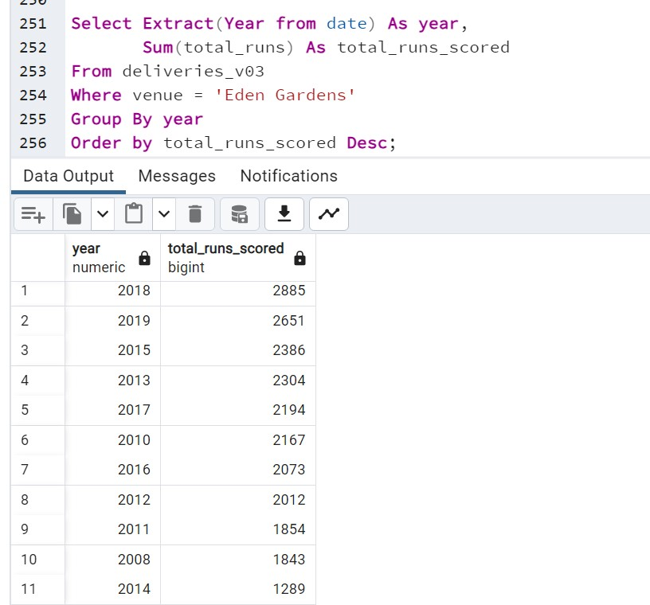
10) Write a query to fetch the year-wise total runs scored at Eden Gardens and order it in the descending order of total runs scored.
Select Extract(Year from date) As year,
Sum(total_runs) As total_runs_scored
From deliveries_v03
Where venue = 'Eden Gardens'
Group By year
Order by total_runs_scored Desc;

Slide 25
Thank You

